Slide 1
Apollo survey
results
March
2017

Slide 2
Apollo survey
OVERVIEW
50 responses, with an average survey response length ~20 min.
Overall feedback:
Look & feel “dated”
Additional training to discover capabilities
Content needs work
WordPress a strong foundation
Notes:
..next, going to go into a series of questions that we used to try and “drill down” into different sections of the template

Slide 3
My website meets our unit's strategic goals in reaching our audiences
49%
35%
14%
Agree
Neutral
Disagree

Slide 4
My website looks professional and represents our unit appropriately
65%
32%
3%
Agree
Neutral
Disagree

Slide 5
I feel confident sending people
to find information on my site
77%
Agree

Slide 6
WHICH MENU STYLE
DO YOU USE?
86%
10%
4%
Default
Mega Menu
Uber Menu
Notes:
Additional thoughts:
Not everyone realizes top level menu items are also pages (that can be clicked, vs. just being headings) (3)
Should be easier to re-order (5):
Drag and drop for page order hard to use (tree view hard to use)
Make pages NOT appear in menu by default
Fit more items

Slide 7
Being able to customize my site's header links is valuable to me
84%
Agree
60%
36%
Seldom
Never
Notes:
84% think its important to maintain this area
..but 60% seldom change them, and 36% never change them
Additional feedback:
More space for more links (4)

Slide 8
Being able to feature my unit's approved social media is valuable
66%
Agree
Notes:
Additional feedback:
...not much – suggestions to move it to footer
Make it easier to embed social media content (Feeds) into pages

Slide 9
My site takes advantage of the
orange call to action button
70%
Agree
51%
28%
20%
Never
Seldom
Often
Notes:
Additional feedback:
A lot of love for it – don’t think much change is needed.

Slide 10
HOME PAGE
FEATURED CONTENT SLIDER
86%
14%
Default Slider
Story Stacker
Notes:
Additional feedback:
A lot of love for it – don’t think much change is needed.

Slide 11
SLIDER Feedback
Hard to find images that “fit” / help in cropping
Get rid of it and create longer homepages
More options for text overlay effects
Looks dated
Notes:
Additional feedback:
Transitions jarring
De-link from news posts
Looks dated (2)
Hard to find images that ‘fit’ (3)
Get rid of it and replace with longer homepage, stacking content (2)
More options editing text overlays (3)
Online cropping/editing of photos before uploading (3)
Change its position on the homepage

Slide 12
Are there enough widgets &
enough places to insert them into
68%
32%
Yes
No

Slide 13
WIDGET Feedback
Drag and drop is too hard to use
Live preview of what a widget will look like
Give us more places to insert widgets
New widget requests:
Better calendar
Photos / videos
Social media feeds
Notes:
Additional feedback:
Drag and drop can be tricky / hard to use (8)
Improve calendar widget
More places to insert widgets (i.e., on specific pages) (2)
Live widget preview (4)
New widget capabilities:
picture/video gallery
facebook/twitter feeds
Countdown
Data tables

Slide 14
ADDITIONAL FEATURES / FUNCTIONS
Search: exclude posts
More advanced calendaring capabilities
Better Google Maps integration (i.e., driving directions)
Better Google Analytics integration / how is my site performing
Button styles
More home page layout options
Browse and enable pre-approved plugins
More CSS style choices

Slide 15
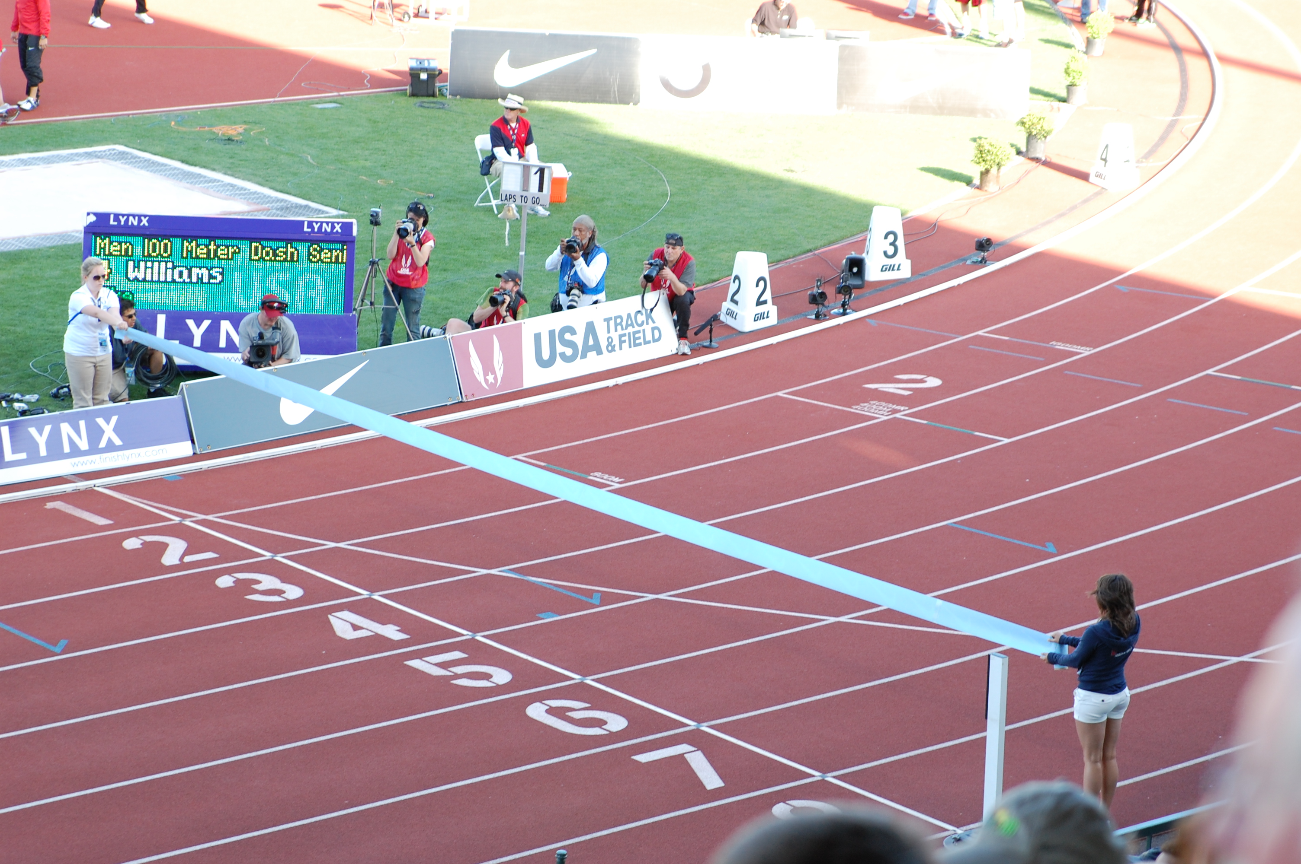
NEXT STEPS
Further analysis of feedback from major stakeholders
Establishment of “requirements”
Concept development
Selection of preferred concept
Programming
Release / migration (Fall, 2017)
Notes:
Q13 - When visitors come to my site, they're most likely trying to accomplish the following tasks:
Q14 - When visitors provide positive feedback about the site, they usually mention:
Q15 - When visitors suggest improvements to the site, they usually mention:
Q25 - I consider the following peer and competitor websites to be most effective (please enter a list of URLs):
Q26 - I consider these sites effective because (please provide detailed feedback on what makes the sites effective. The more detailed you can be, the better we can use your feedback to make improvements to your site):

